Slide 1









WORK
IN
PROGRESS
FREEMAN URBAN STORE

Slide 2






Shreya Singh
Introduction and Initiation Phase
Yunik Pandey
Planning Phase
Sujit Gyawali
Database Design
Team Members
Aavash Chand
Requirement Catalouge
Sushrut Rimal
Logo and Wireframe
Sushant Neupane
Website Development

Slide 3
TABLE OF CONTENTS
1.Initiation Phase
3.Executing Phase
Project Charter
Meeting Agenda
Database Design
Team Contract
Use Case Diagram
Logo Design
Wireframe
2.Planning Phase
Requirement Catalogue
Belbin Analysis
Website Development
Skill Audit
Functional and Non Functional

Slide 4
MEETING AGENDA
Week 1
Discussion on ERD and EERD
Login and Register page mockup design concept
Week 2
Jira Workflow
ERD Explanation
Week 3
Team members learned the basics of git and how the project will be updated and shared.
Week 4
Linked with figma with every team member.
Team members learned to use figma.

Slide 5
MEETING AGENDA
Week 5
Discussion on Login and Customer Registration FrontEnd Development.
Discussion on how to move forward for submission of ERD, EERD, Composite, Decomposite, Wireframe within next week.
Week 6
Completed EERD and ERD
Worked on wireframe and completed Skill audit and Belbin Analysis.
Week 7
Worked on remaining wireframes
Discussed on use case diagram

Slide 6
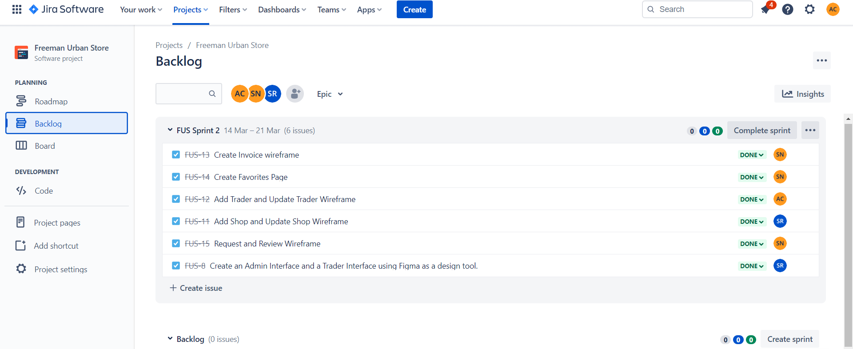
Communication Tool Used
Jira for setting agenda
https://freemansurbanstore.atlassian.net/jira/software/projects/FUS/boards/2

Slide 7
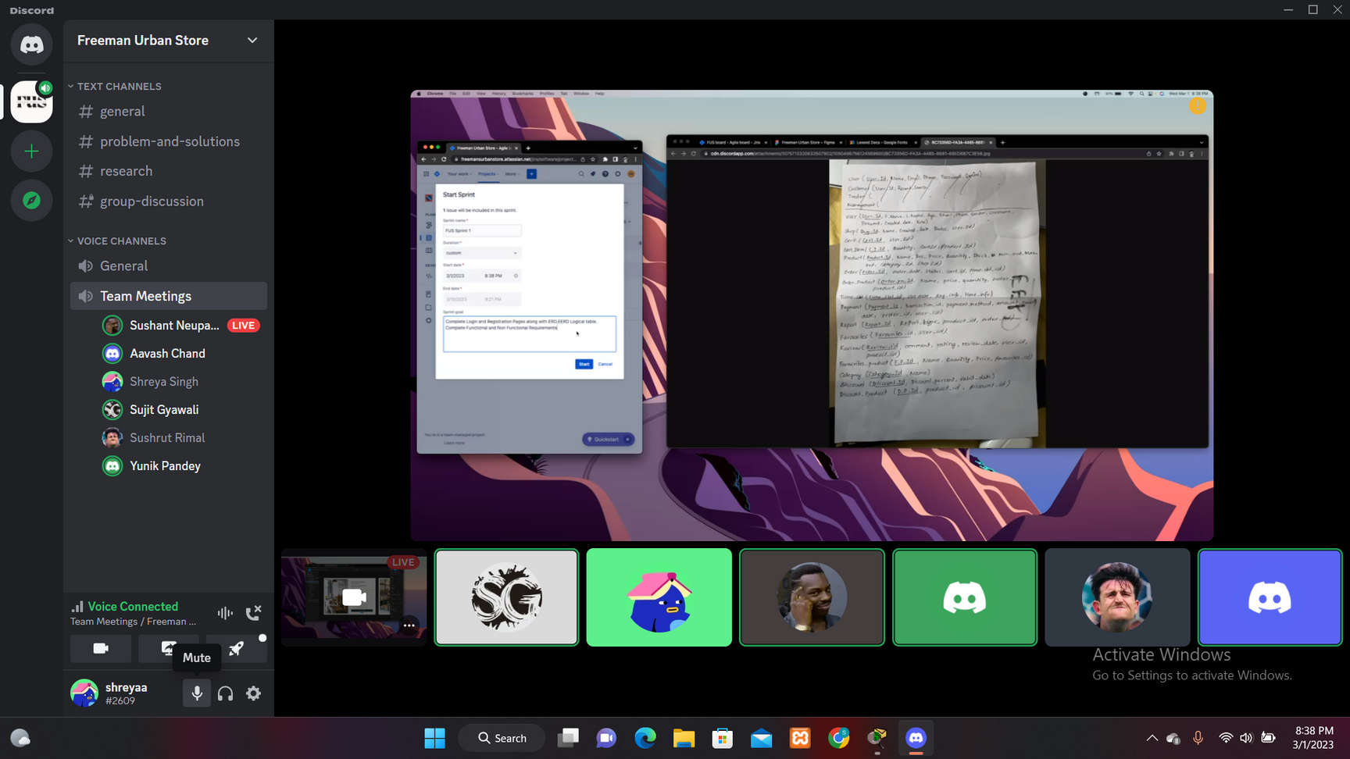
Discord Meeting
https://discord.gg/YxpMUH8r

Slide 8
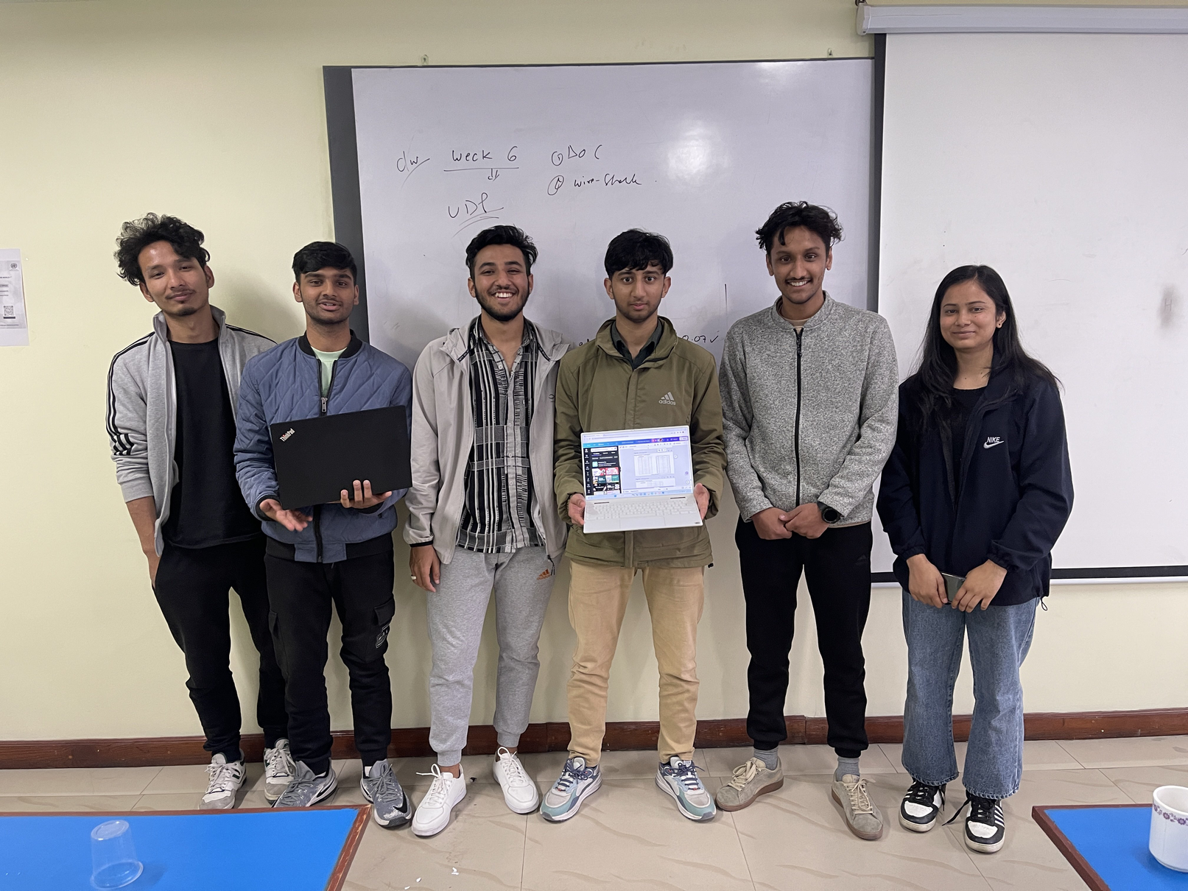
Physical Meeting

Slide 9
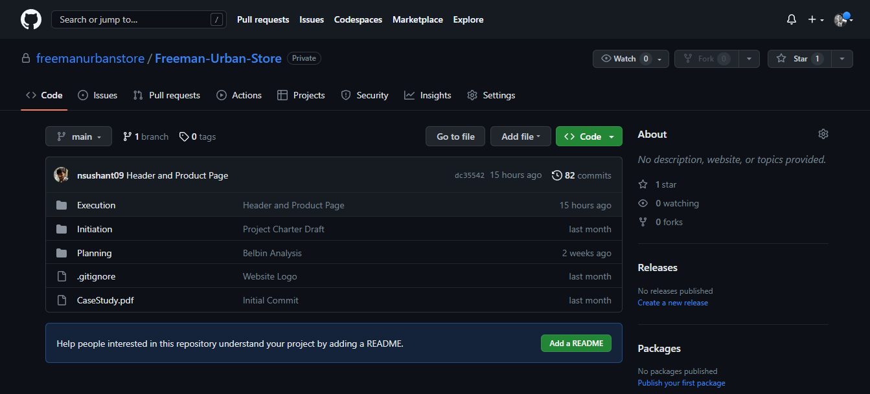
GitHub
Used for working on project together
https://github.com/freemanurbanstore/Freeman-Urban-Store

Slide 10

INITIATION PHASE
Project Charter
Team Contract

Slide 11
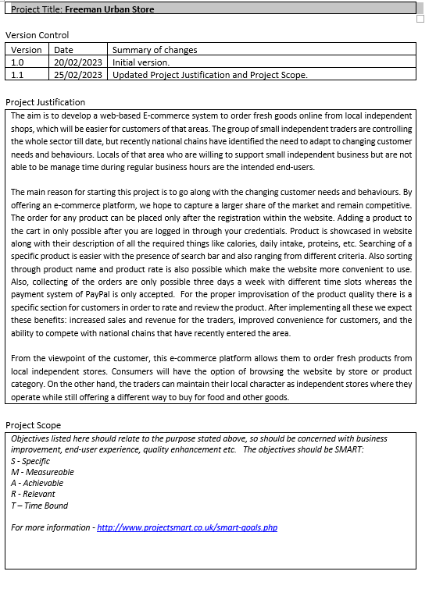
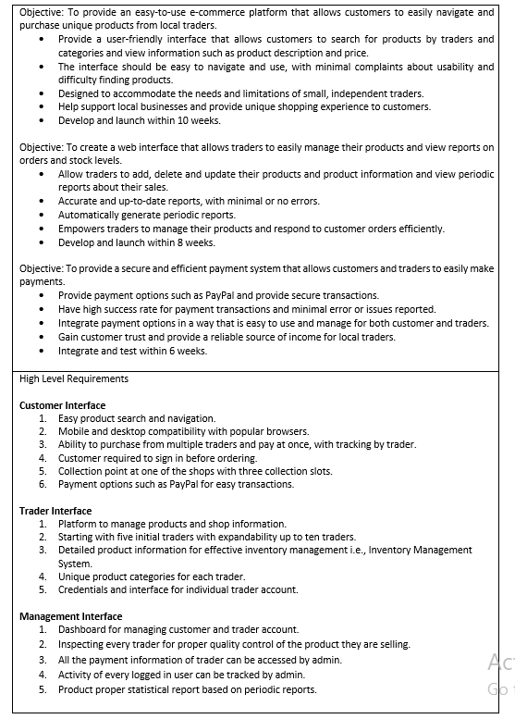
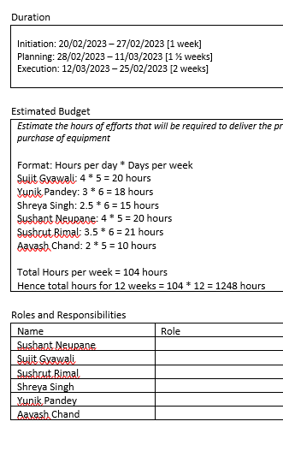
Project Charter

Slide 12
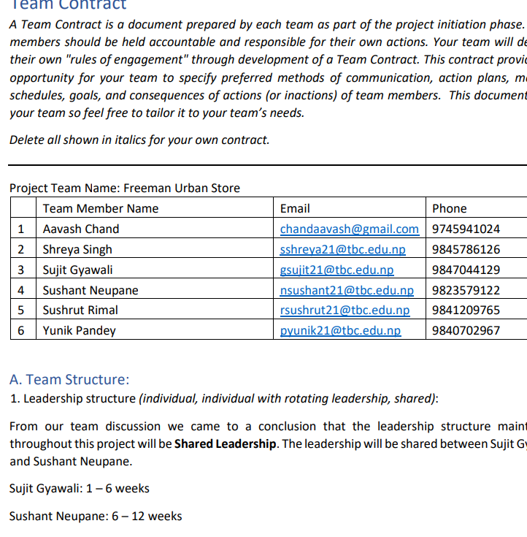
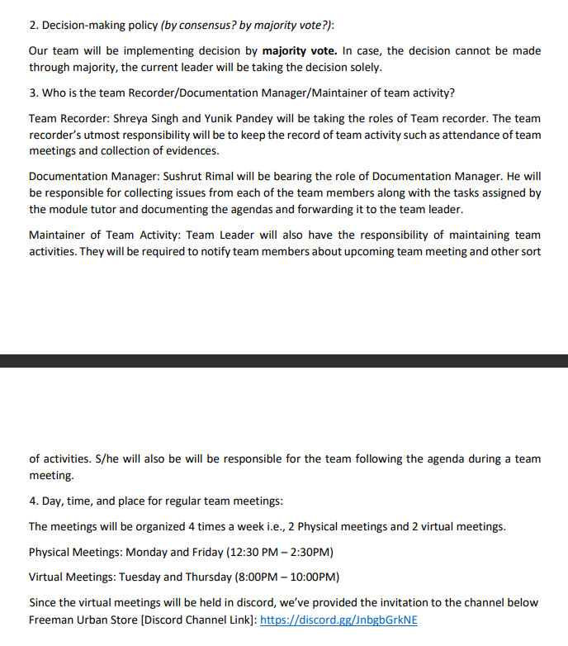
Team Contract

Slide 13
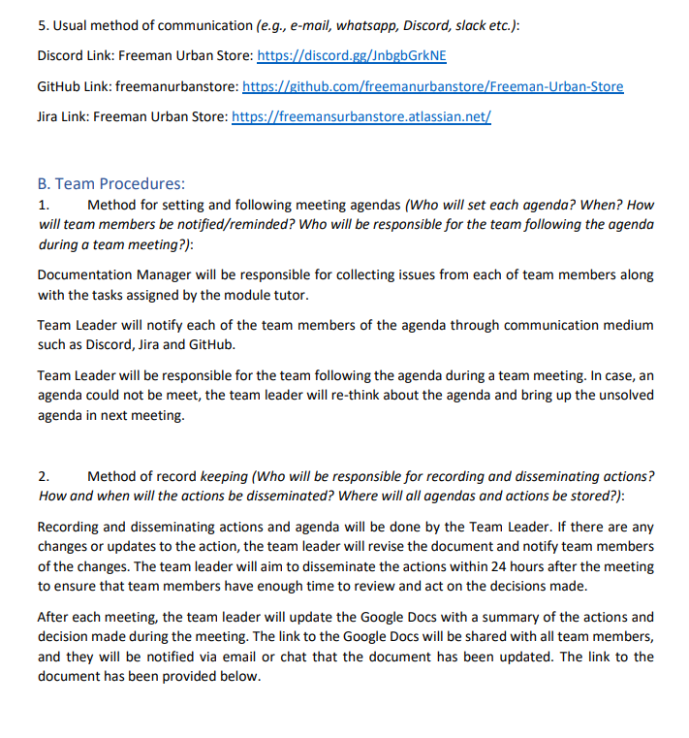
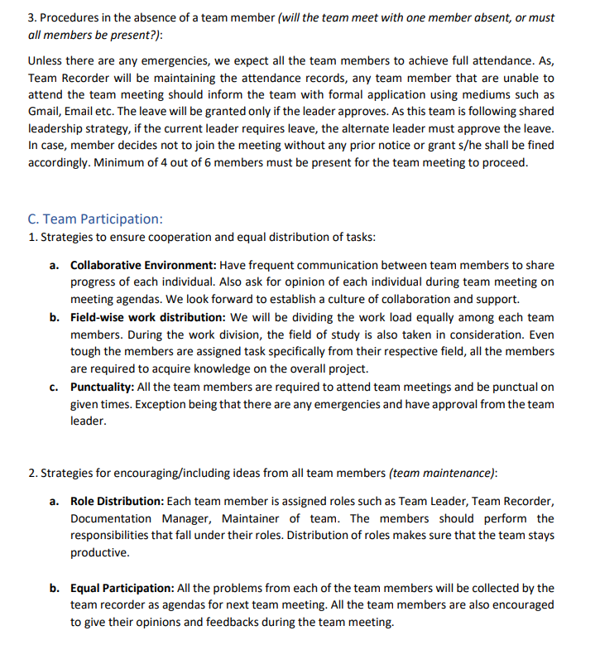
Team Contract

Slide 14
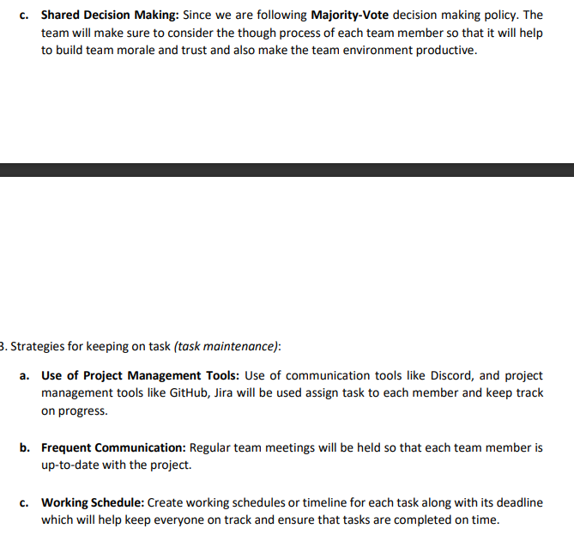
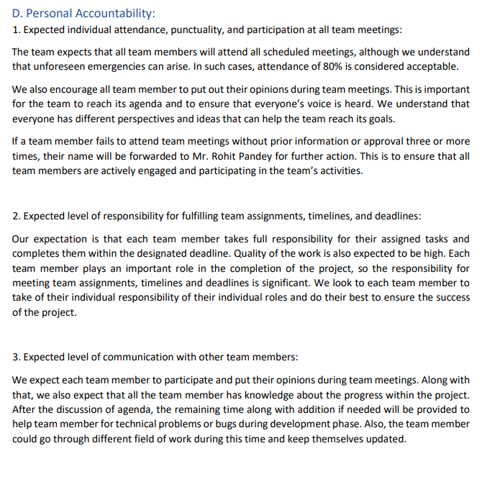
Team Contract

Slide 15
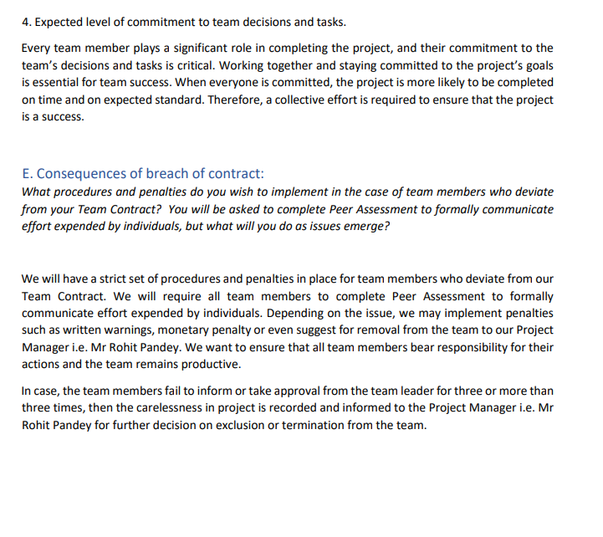
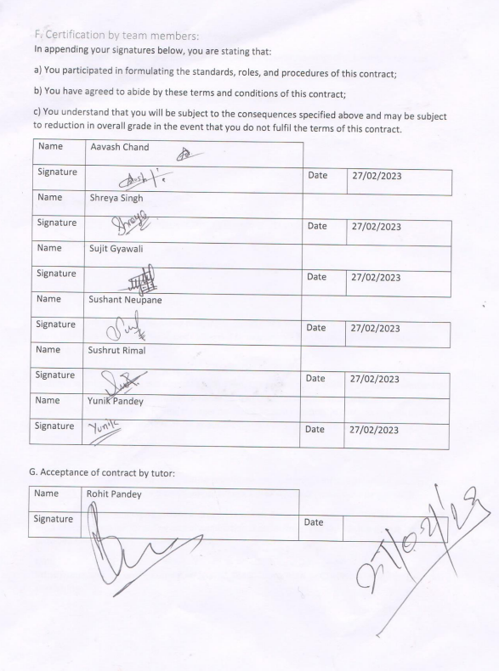
Team Contract

Slide 16
PLANNING PHASE
SKILL AUDIT
BELBIN
ANALYSIS
MICROSOFT
PROJECT

Slide 17
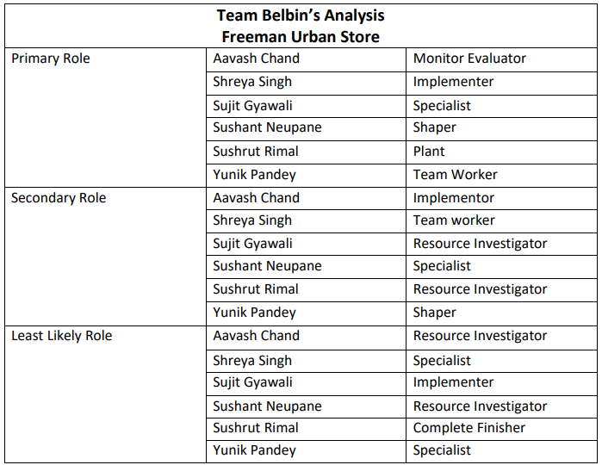
Belbin Analysis

Slide 18
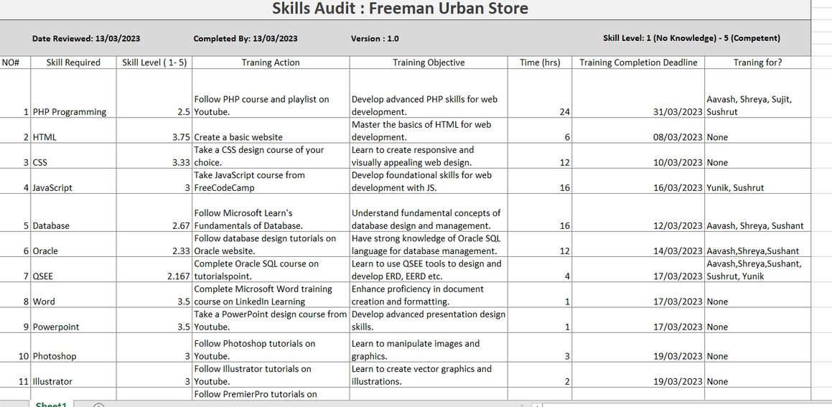
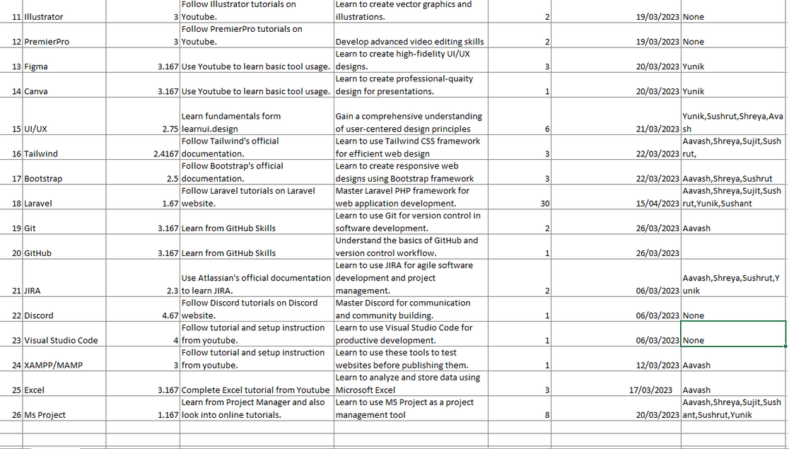
Skill Audit

Slide 19
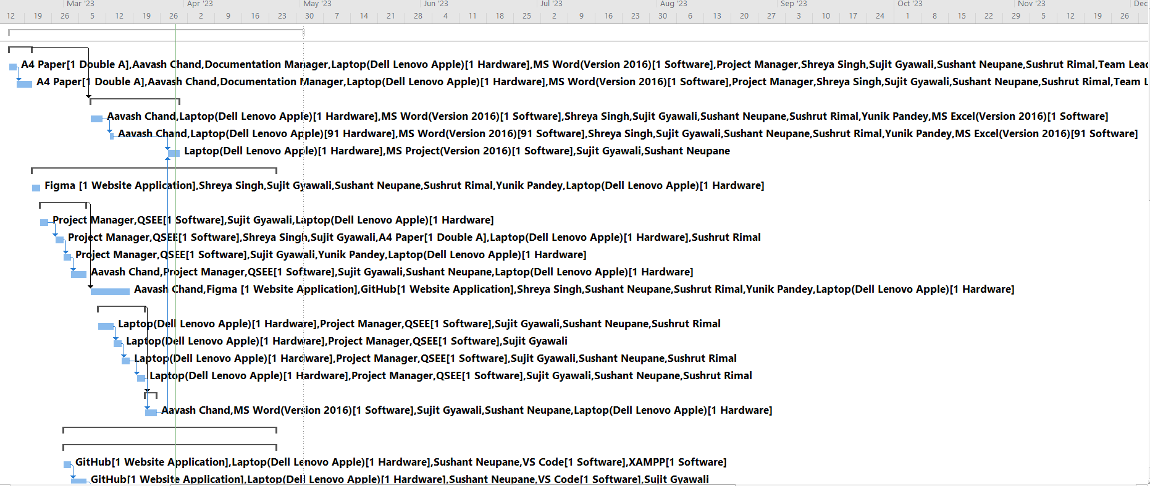
MS PROJECT
GNATT CHART

Slide 20
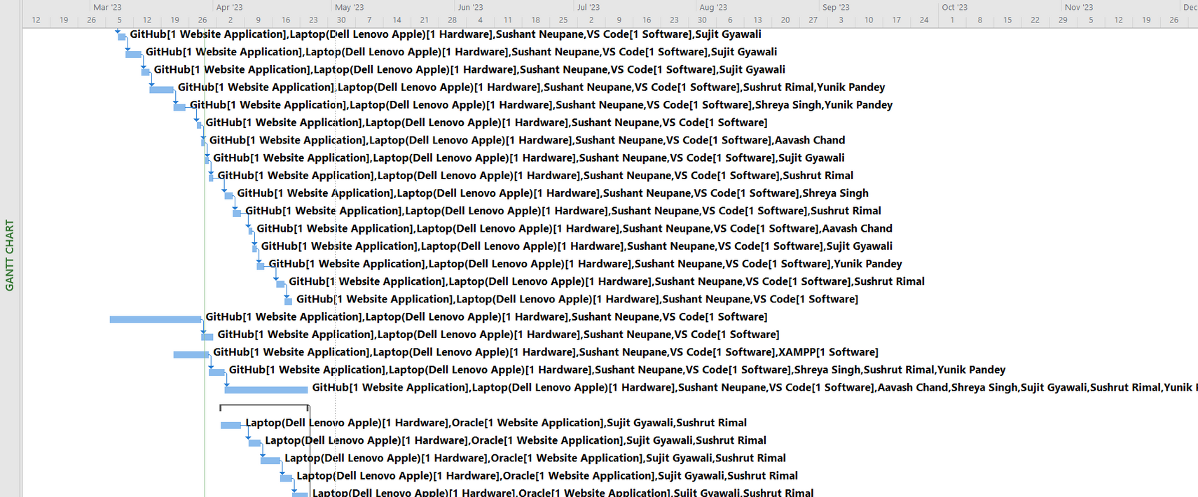
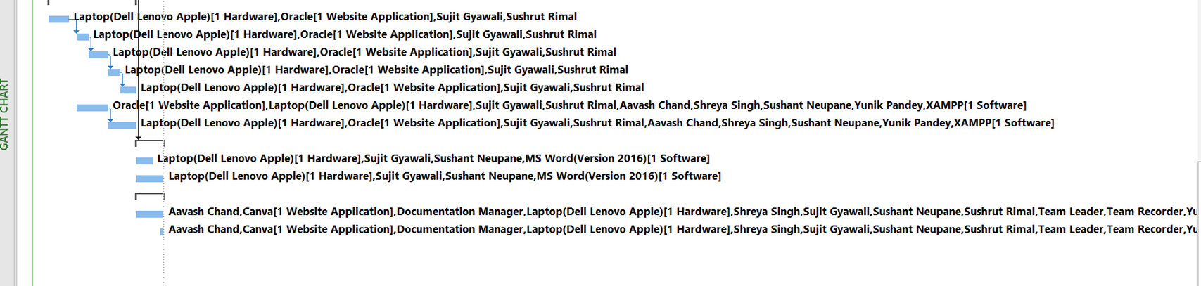
MS PROJECT

Slide 21
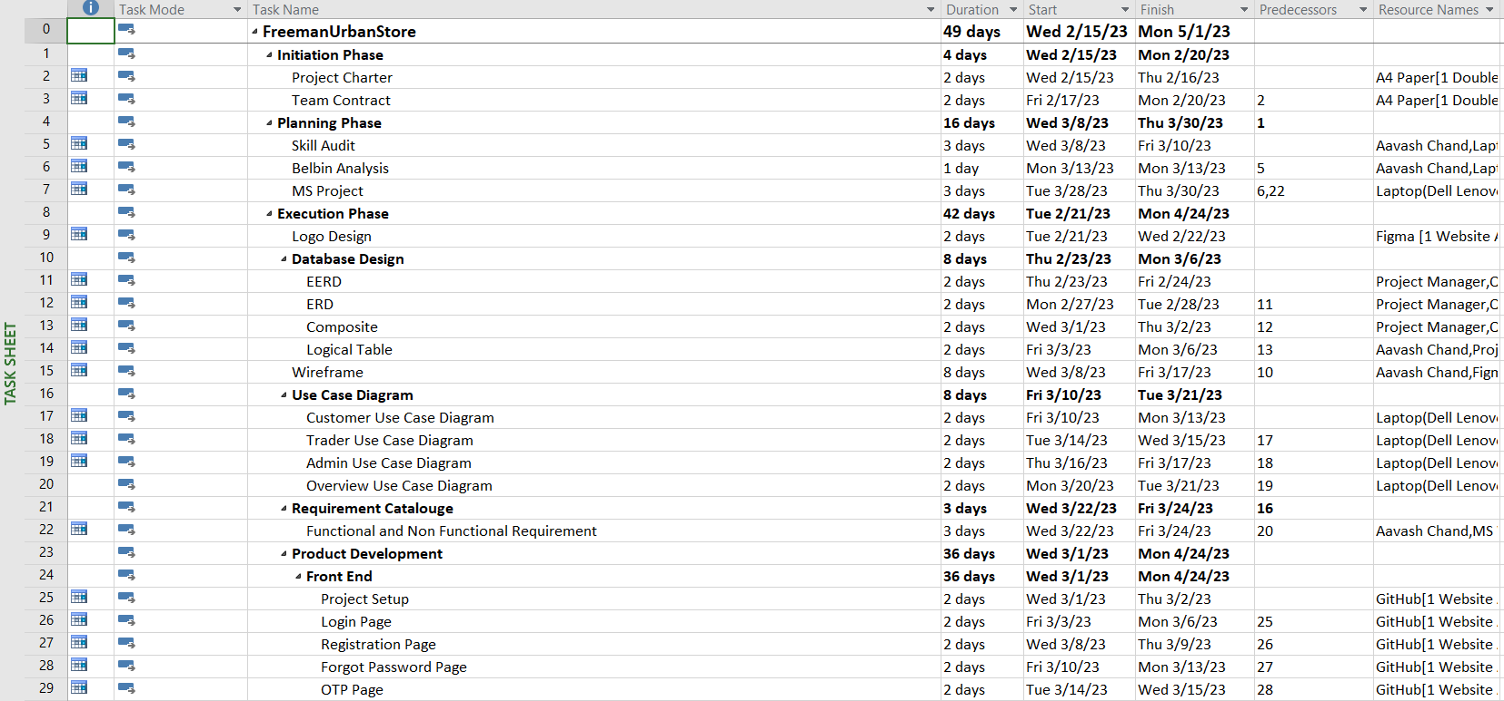
MS PROJECT
TASK SHEET

Slide 22
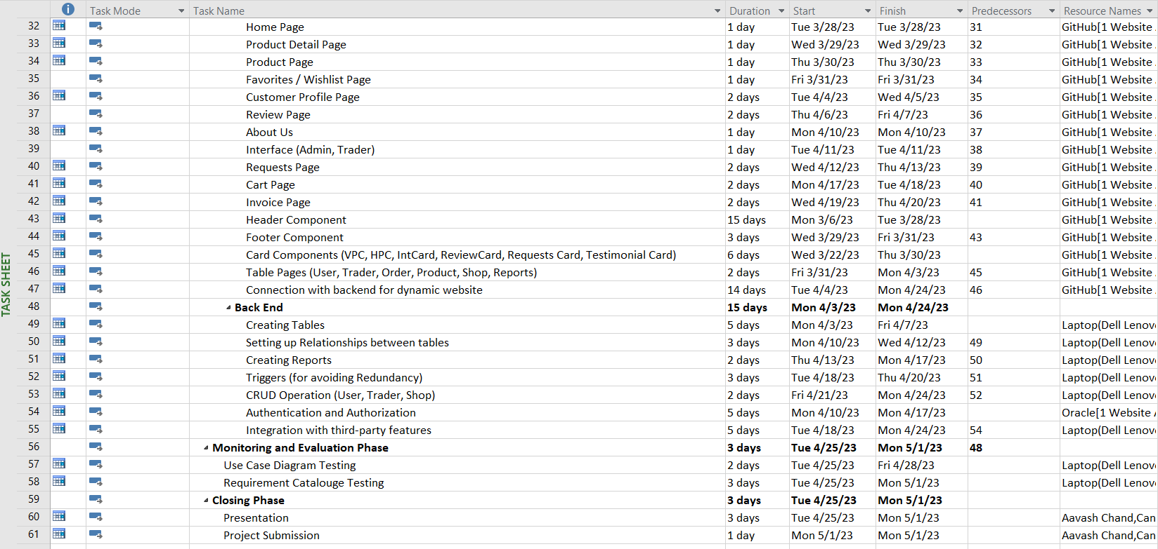
MS PROJECT

Slide 23
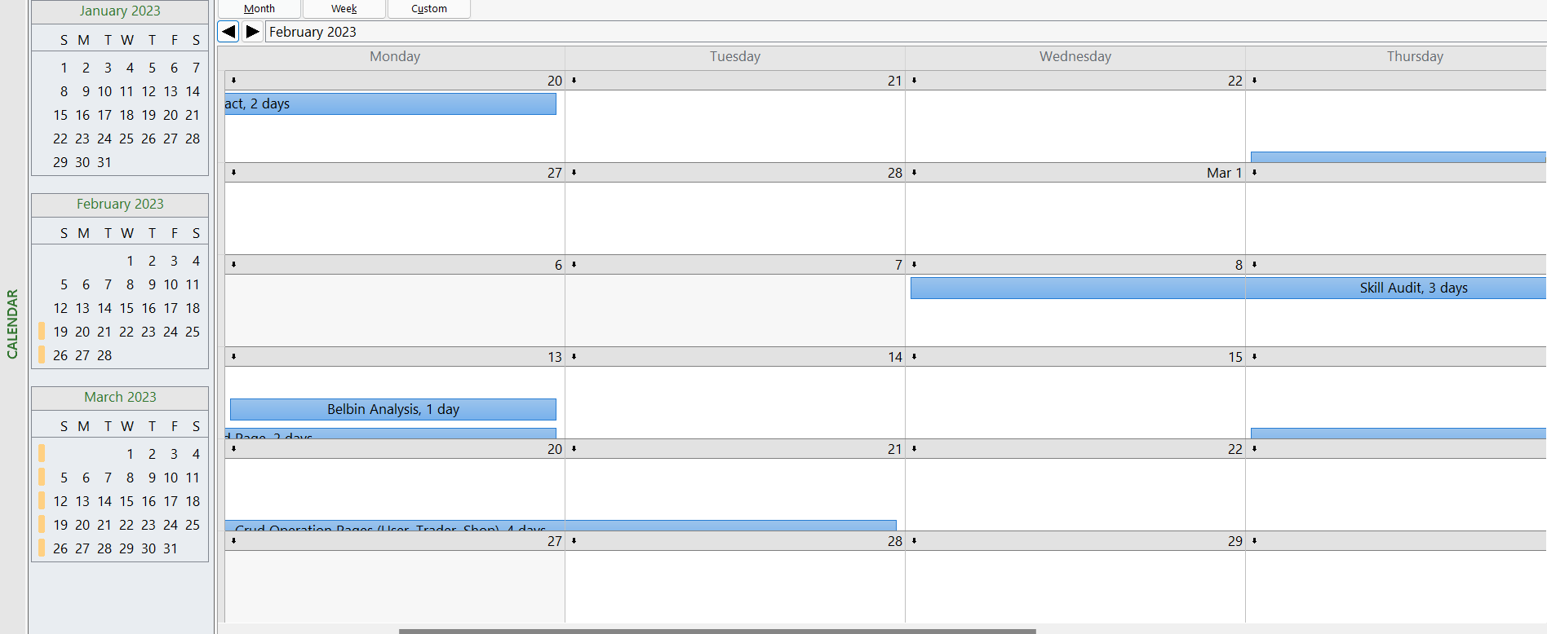
MS PROJECT
CALENDAR

Slide 24
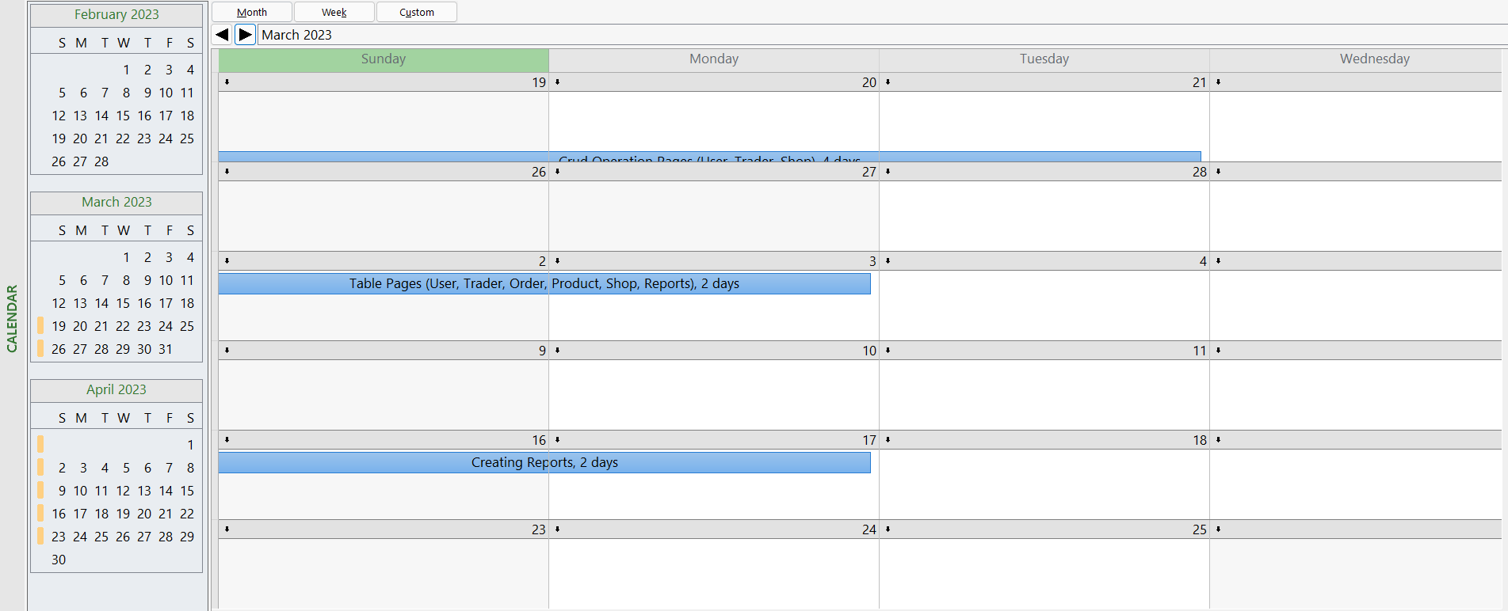
MS PROJECT
CALENDAR

Slide 25
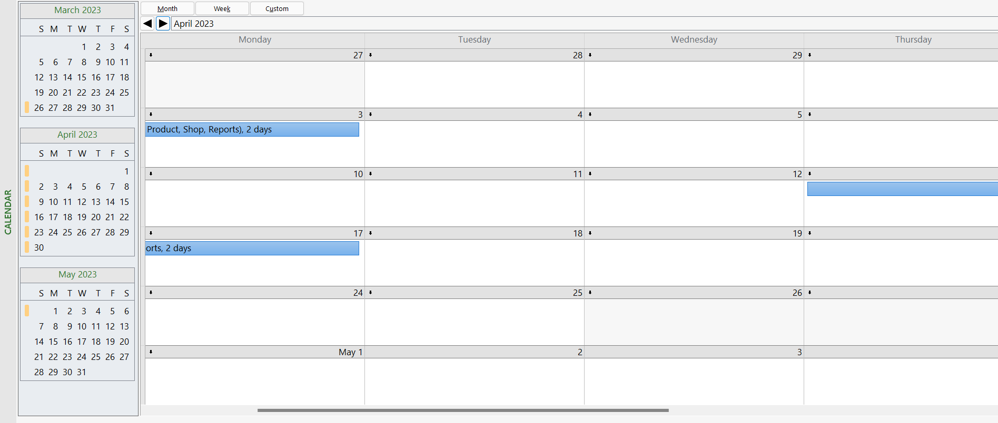
MS PROJECT
CALENDAR

Slide 26
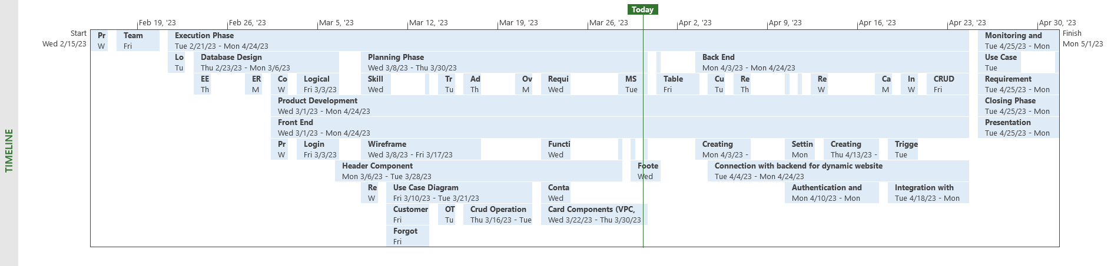
MS PROJECT
TIMELINE

Slide 27
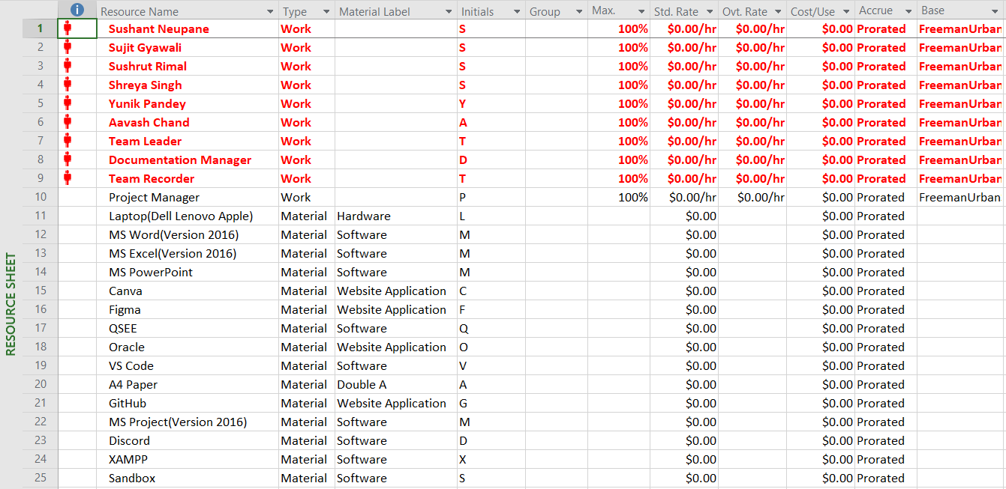
MS PROJECT
RESOURCE SHEET

Slide 28
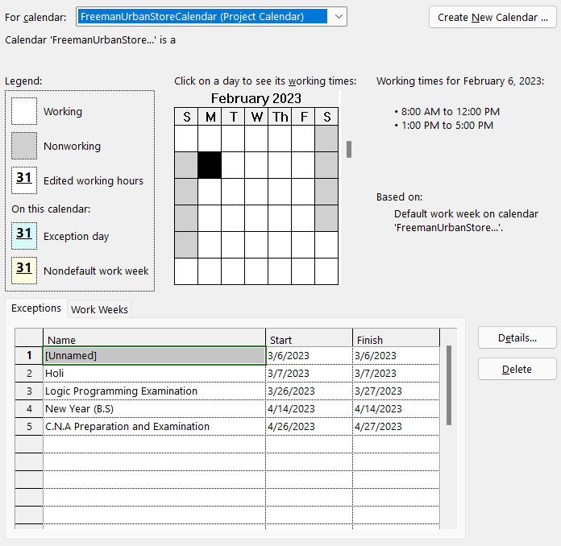
MS PROJECT
HOLIDAY

Slide 29
EXECUTION PHASE
Final Composite Diagram
ERD
EERD
Logical Table
UseCase Diagram
Functional &
Non-Functional

Slide 30
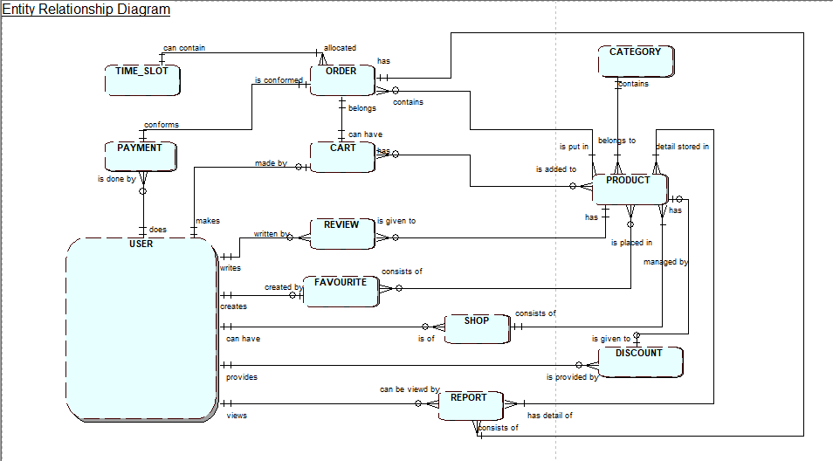
Entity Relationship Diagram

Slide 31
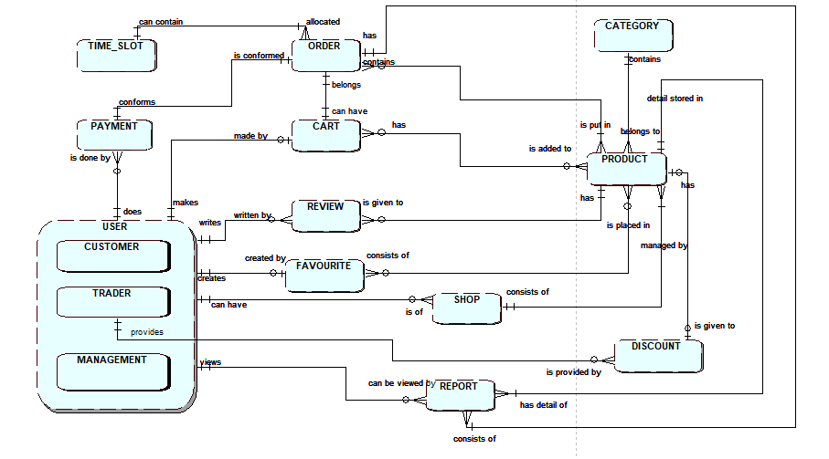
Extended Entity Relationship Diagram

Slide 32
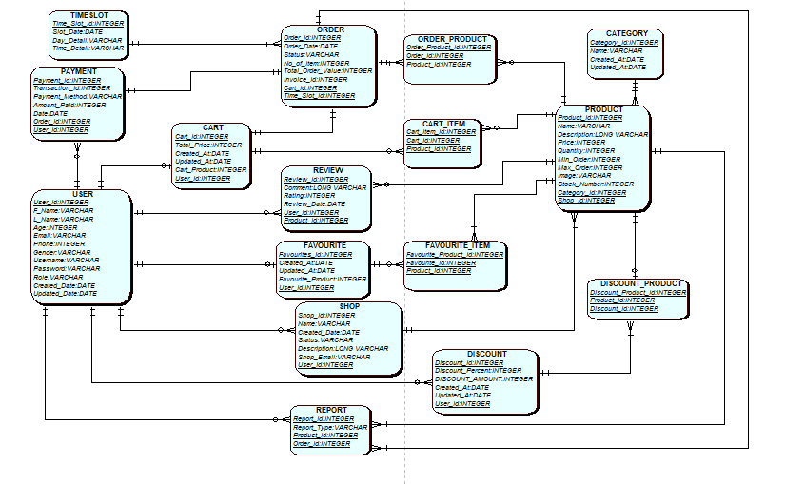
Final Composition Diagram

Slide 33
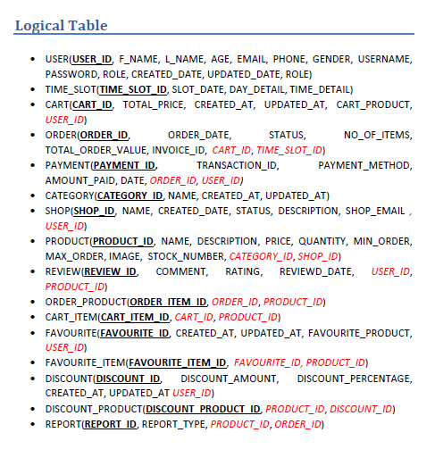
Logical Table

Slide 34
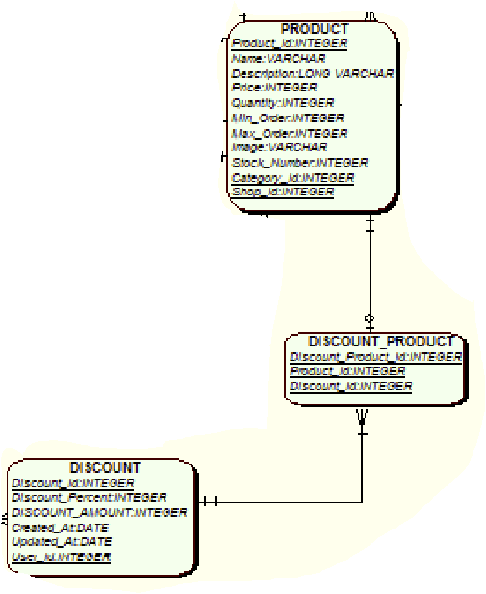
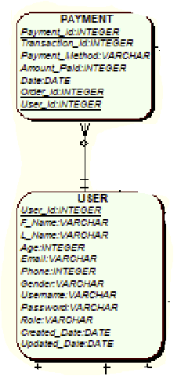
Relation Between Product and Discount
Relation Between Payment and User

Slide 35
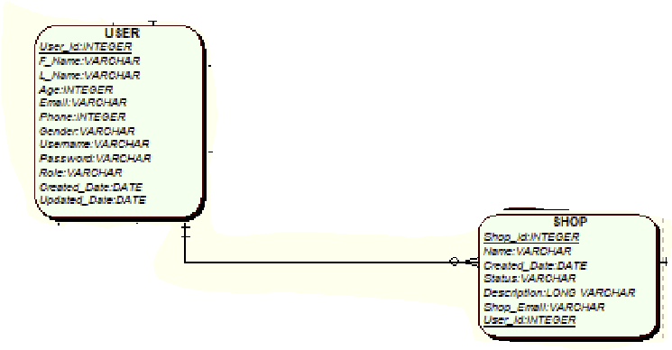
Relation Between User and Shop

Slide 36
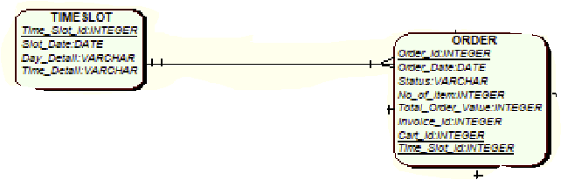
Relation Between TimeSlot and Order

Slide 37
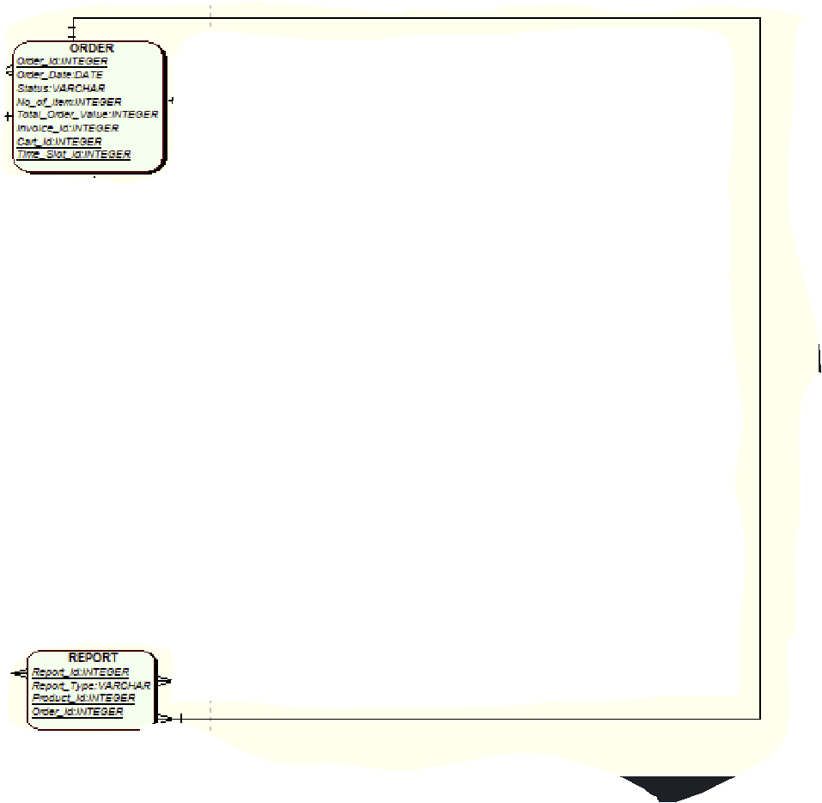
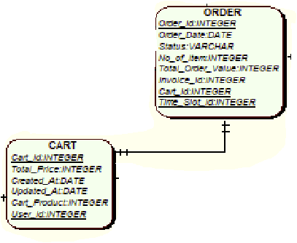
Relation Between Order and Report
Relation Between Order and Cart

Slide 38
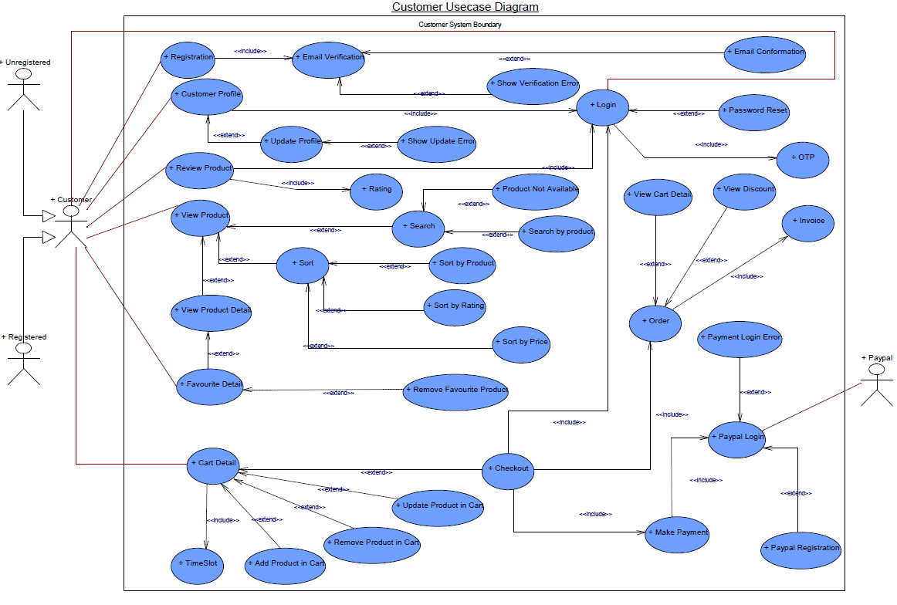
Customer UseCase
Diagram

Slide 39
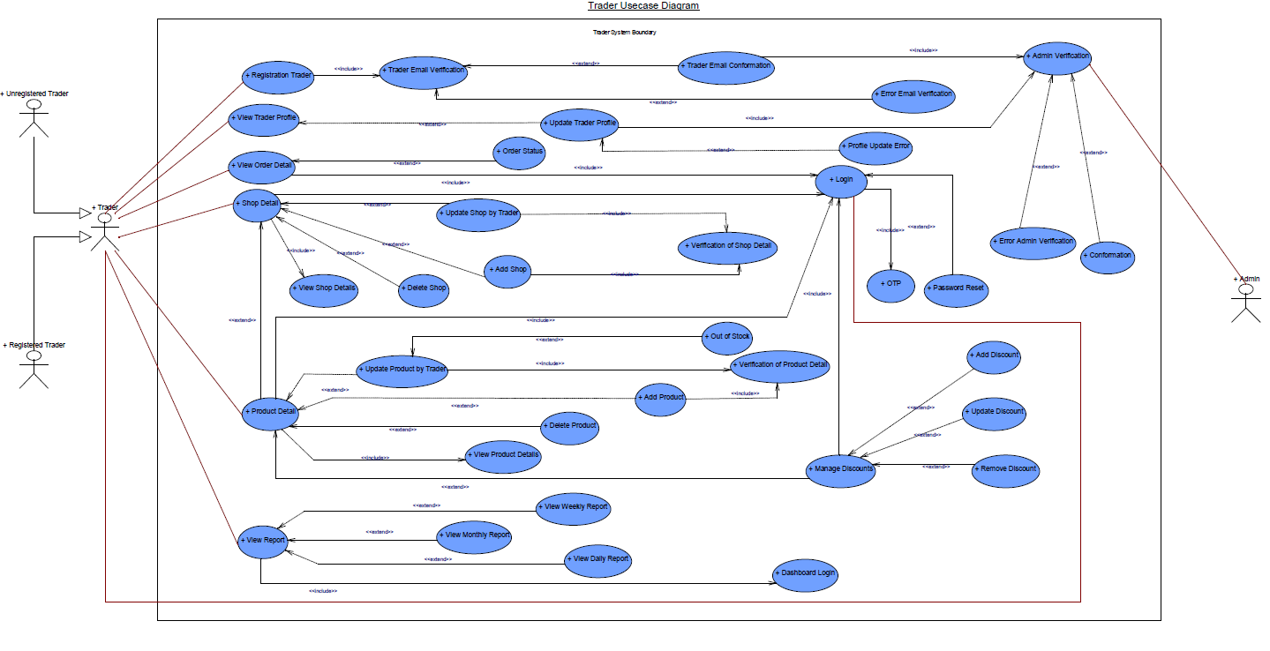
Trader UseCase Diagram

Slide 40
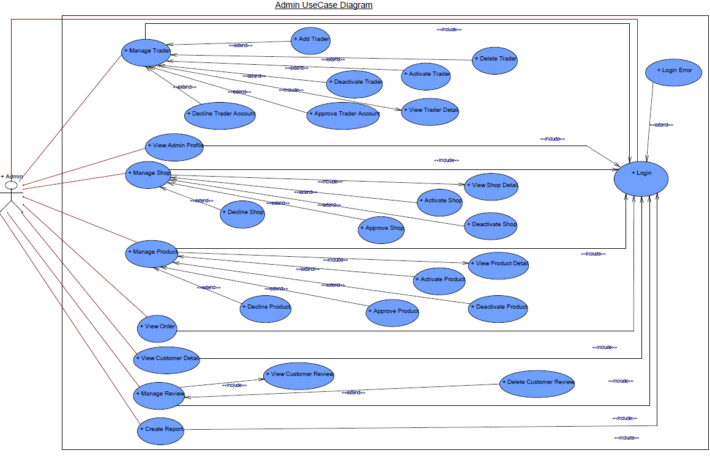
Admin UseCase
Diagram

Slide 41
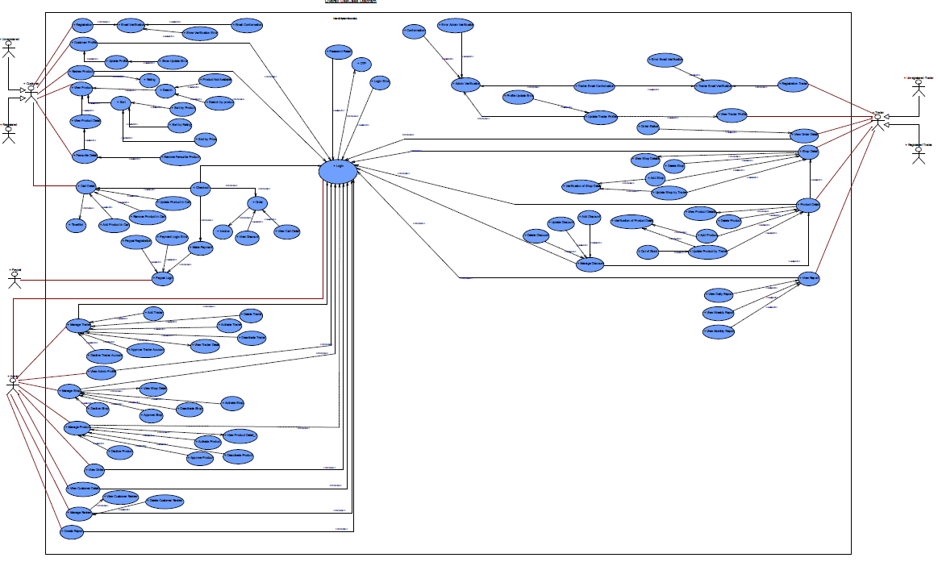
Admin UseCase Diagram

Slide 42
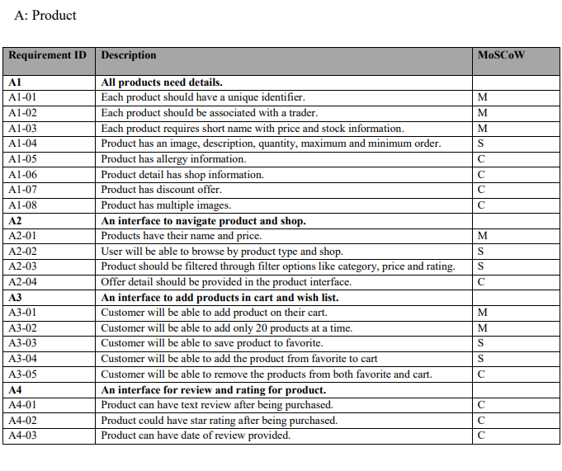
Requirement Catalogue Functional
(Product Detail)

Slide 43
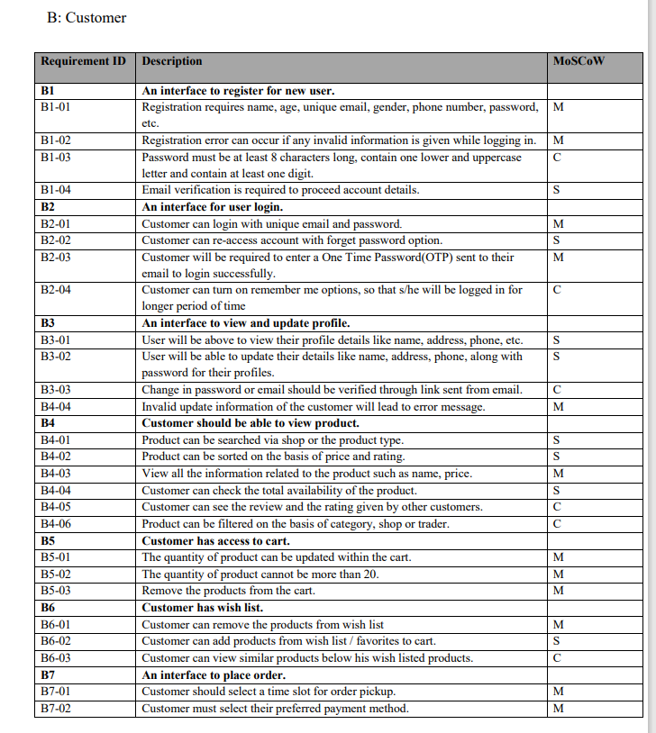
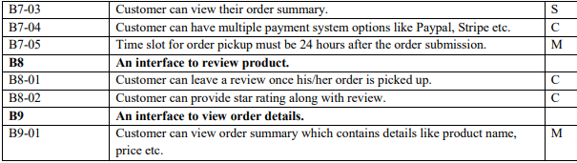
Requirement Catalogue Functional
(Customer Detail)

Slide 44
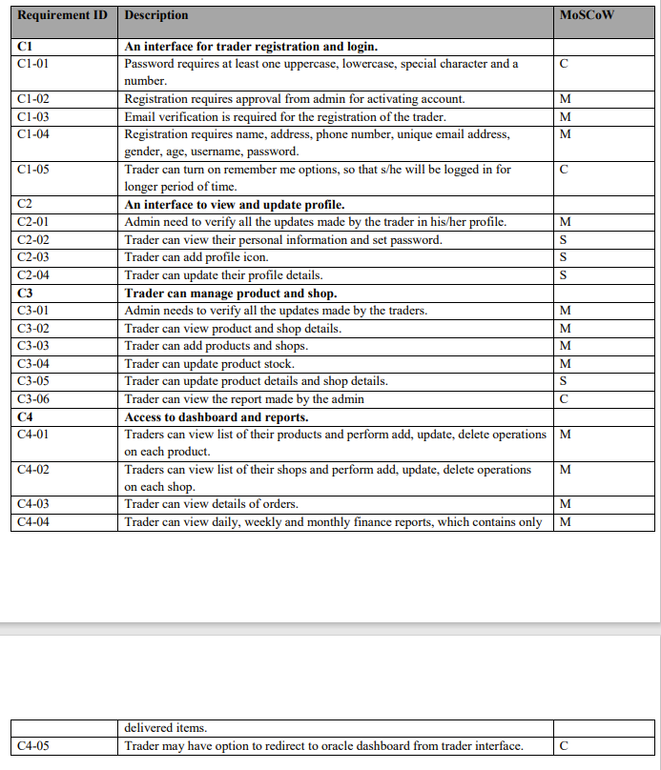
Requirement Catalogue Functional
(Trader Detail)

Slide 45
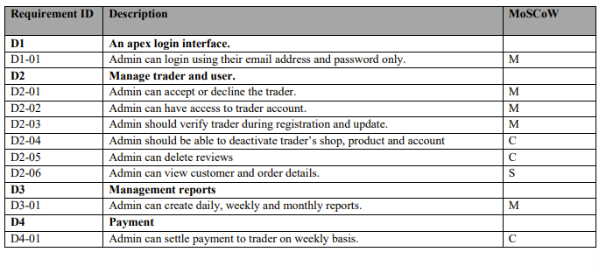
Requirement Catalogue Functional
(Admin Detail)

Slide 46
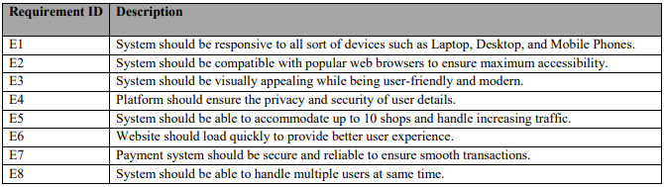
Requirement Catalogue Non-Functional

Slide 47


LOGO
Dark Logo
Light Logo

Slide 48
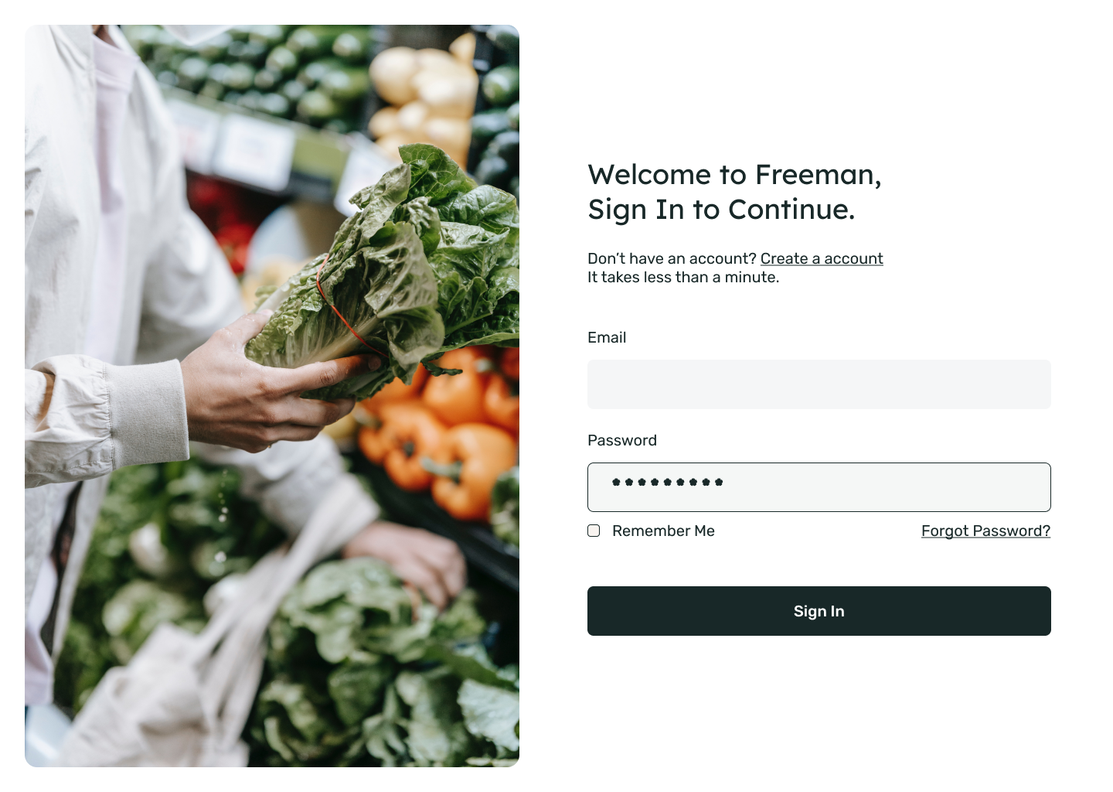
WireFrame Login

Slide 49

Wireframe Customer Register
Similar Pages :
Trader Registration

Slide 50


WireFrame Home Page & Product Detail

Slide 51


WireFrame Cart & AdminInterface (Similar to trader interface)

Slide 52

WireFrame Invoice

Slide 53

Wireframe Table Product
Similar Pages :
User
Order
Trader
Shop

Slide 54
Website Development
Back-End Development
PHP
Oracle
Front-End Development
HTML
CSS
JavaScript
Tailwind

Slide 55


Project Setup
Utils file that contains project wide used functions.

Slide 56


Project Setup
The images shows that table are generated by passing title and values to a function.

Slide 57


Project Setup

Slide 58


Login
This page allows users to be signed in.

Slide 59


Register
This page allows users to be create account as a customer.

Slide 60


Home Page
Front most page that the user will be directed to.

Slide 61


Product Page (Search)
The search bar will be redirected to the product page.

Slide 62


Product Detail
Users can add and look at items to their cart or favorites.

Slide 63


About us
This page describes about us and contains testimonials from our customers

Slide 64


Admin Interface
Admin can have access to all the details.

Slide 65
THE END

